Slide 1
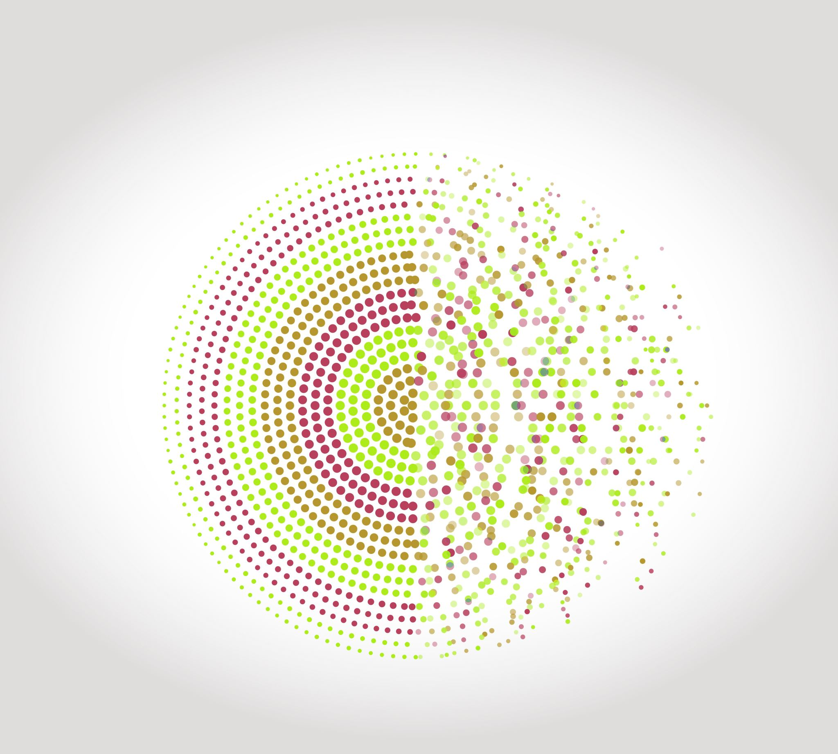
Real Time Facial Emotion Recognition System
BY
Chaitanya Beeram
Shravani singam
SWETHA POLAVARAPU

Slide 2
Introduction
Facial expression plays an important role in detecting person’s emotion and it is a most genuine form of feedback that can be given. We have the ability to accurately detect and identify an emotion .
In this we project we are developing a model which can detect upto seven distinct facial emotions. This project runs on top of a convolutional neural networks(CNN) that is built with the help of Keras whose backend is tensorflow in python. The facial emotions that can be detected and classified by this system are Happy, Sad, Angry, Surprise, Fearful, Disgust, Neutral.

Slide 3
Dataset Description
The dataset that we are using is FER2013 and subset of COCO dataset which consists of data in the form of csv files. It has a csv files named as fer.csv.
FER 2013 contains 35,887 images ,48*48 pixels. This csv files three attributes emotion, pixels, mode.
COCO is a large-scale object detection, segmentation and captioning dataset. We are using Test 2015 which has 81,434 images.
This dataset is cleaned and prepared i.e All strings are converted into int and divide the dataset into testing and training, handling any missing values and duplicate values. By doing the above process the accuracy of the model is increased.

Slide 4
Building the model
Deep learning in AI is used to mimic human brain. So, we are using deep learning to build this model as it has to detect emotions.
The architecture of this deep learning model is based on Convolutional Neural Networks.
We use computer vision library i.e Open CV uses digital images from cameras and videos and deep learning models, machines can accurately identify and classify objects — and then react to what they “see.”
Tensorflow is a famous library when dealing with deep learning neural networks as it is easy to build and deploy applications. Whereas Keras is high-level Library used on the top of tensor flow. Keras provides API to quickly build network.
.

Slide 5
Training the model
We give no of images of training data ,testing data ,batch size and epochs.
Then we use image data generator which generates batches of tensor images with real time data augmentation, the data will be looped over in batches.
We use rescale by which we will multiply the data before any other processing . Our images have RGB coeeficients 0-255. But such large values would be too high for our models to process. So, we target values between 0 and 1. Thus, we scale with scaling factor 1/255.
Then we use sequential model which allows to create layer by layers in step by step fashion. Then we use Conv 2D, Max pooling, Dense, Flatten layers and also Dropout from keras.

Slide 6
Training the model(continued)
So, we decided to start from using 2 sequential convolutional layers followed by a Maxpooling layer, “relu”s used as common activation function.
Conv 2D layer applies a filter to an input that creates a feature map that gives the summary of the detected input images.
Maxpooling layer down-sizes the input representation reduces the dimensionality of the image to observe the features better.
To help prevent overfitting Dropout function is used, it is a probabilistic way of removing the inputs from previous layers. This step makes network robust to the inputs.
The Flatten layer reshapes the tensor which is equal to the elements in the tensor, this step is generally done before the dense layer.
The Dense layer generally, changes the dimensions of the vector. Mostly using dense layer, the dimension is increased.

Slide 7
Accuracy and Testing
After we train the model we get the accuracy and accuracy plots.
In our project we got training accuracy as 85% and testing accuracy 60%
When we run the model in display mode, the webcam will be on and it detects the face of a person using computer vision and draws a bounding box around the face using harr cascade file around the persons face and then using the nearest neighbours detects the emotion and displays it on the screen.

Slide 8
Uses
Health systems
Aided Driving
Mental diseases diagnosis
Feedback of online class
Can also be enhanced and used in Interviews to know the feeling of the candidate.
Market Research
Testing for video games etc.

Slide 9
Enhancements
1) The to enhance the model we tried to enhance the model by improving the data set with the images from COCO dataset.
2) Intially the reference model used static images to detect emotions and we used CV from a different reference to implement it in real time.
3) We created additional layers in CNN for faster processing of real time video image
4) The model can also detect multiple faces and their emotions in the same frame
5) The display model can instantly be used to verify the performance of the model unlike the previous model which is entirely static.

Slide 10
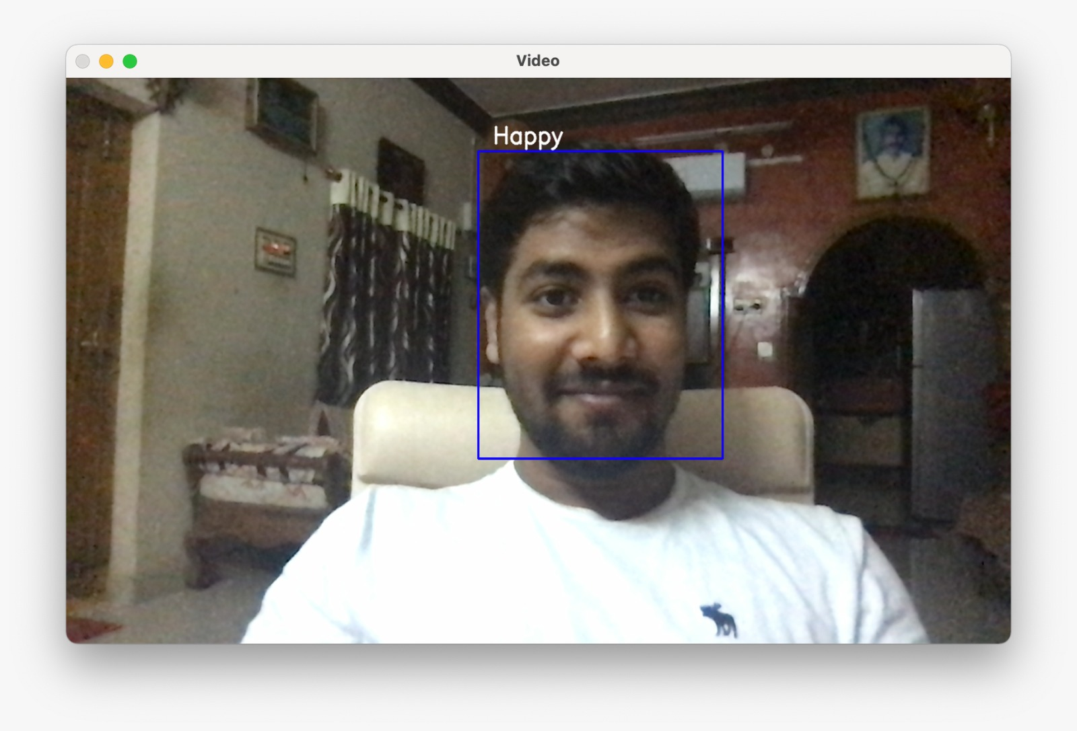
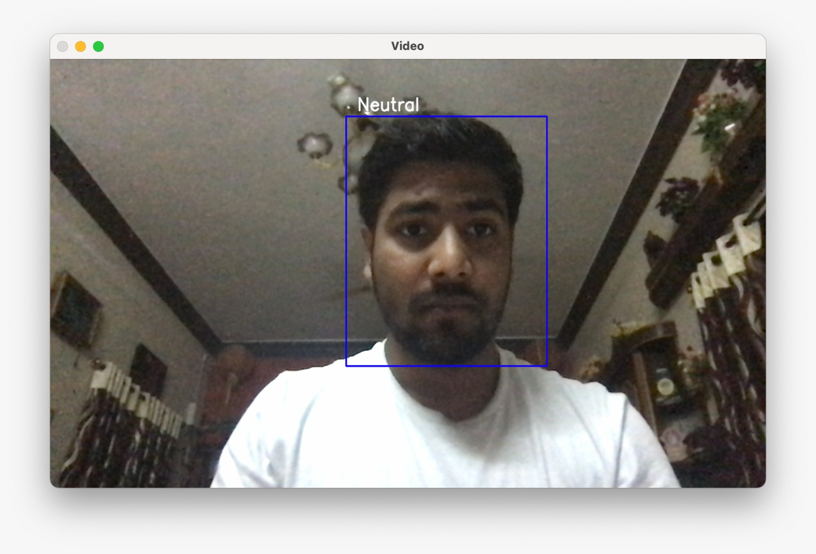
How the system works:

Slide 11
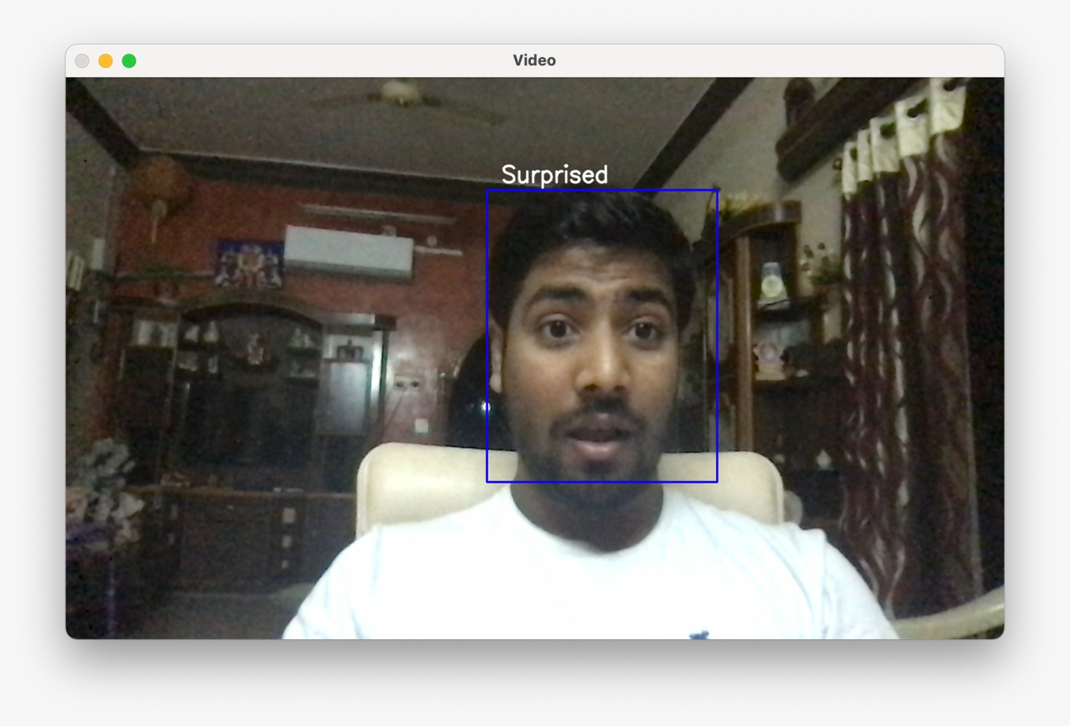
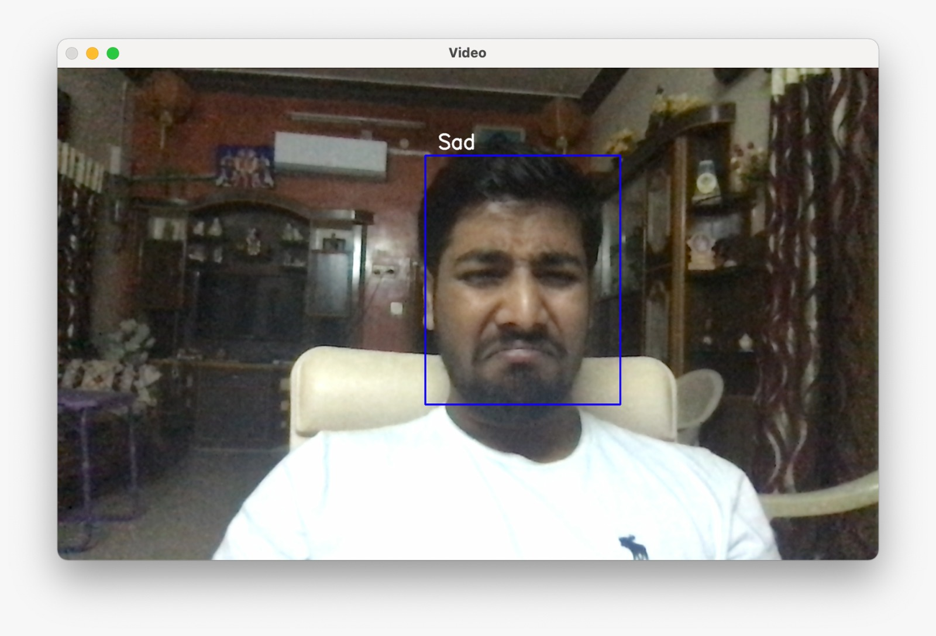

Slide 12
Conclusion
With the idea we have we built a efficient facial emotion recognition system which performs emotion detection by analyzing the user image from the webcam using OpenCV. We should be able to include a sleepiness detection feature into the model if an alternate approach of this deep learning algorithm can be constructed. At the End of the day, putting more work into the dataset can lead to even better accuracy and performance metrics.

